Slide 1
Data Warehousing With IBM Cloud
Indranil Bakshi
P.Karthick
S. Dhinakaran
V.Loganathan
S.MadhanRaj

Slide 2
IntroDuction About the Datawarehouse
Datawarehousing is a method where the huge amount data for different categories are stored by the Organization.
It can provides:
Historical Data
Derived Data
Meta Data

Slide 3
Need of Datawarehouse:-
The main need of Datawarehousing is to provide valuable data to some organization which can be used for analytics,Model training for future purpose.
Which can help to achieve the better accuracy and efficiency.

Slide 4
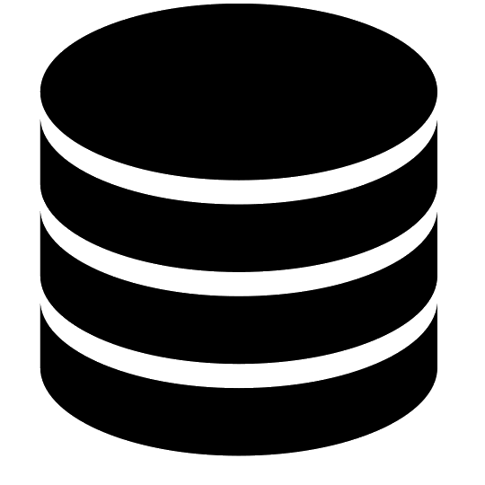
Organizations Can have their Own Datawarehouse or they can borrow the data from Another Datawarehouse
Own
Another

Slide 5

Procedure for Datawarehousing:-
In datawarehousing data are stored in the cloud,the datas are store into the server which can be access be using the internet.

Slide 6
Portions for Datawarehousing:-
So Now we can understand that the main three things are needed for the datawarehousing
Datas
03
Internet Access.
Server
01
02

Slide 7
So for build a Datawarehouse The cloud system is the crucial component.
Cloud System

Slide 8

So here IBM Cloud is helping Us
To provide a Cloud service which is useful for large datawarehousing

Slide 9
IBM Provides
The Cloud Services along with
Security
Access Control
Efficiency
Risk Optimization
Logging And Monitoring
Networking

Slide 10
IBM Provides For
The Cloud Services For
AI Machines
Block Chain
Analytics
Automation
Computation

Slide 11
Services Offers it for Organization
Item 1
Item 2
It Provides
It’s very helpful for those organization which are working on the Data analytics and model building and training also for that companies which wants to create their on Warehouse. Which is very useful.
Benefits
More efficient
More reliable
More Secure
Optimized Risk Control
39
4
29
27
4
5
20
35
5
25
22
15
20XX
20XX
20XX
20XX

Slide 12
Thank You !

